Slide 1
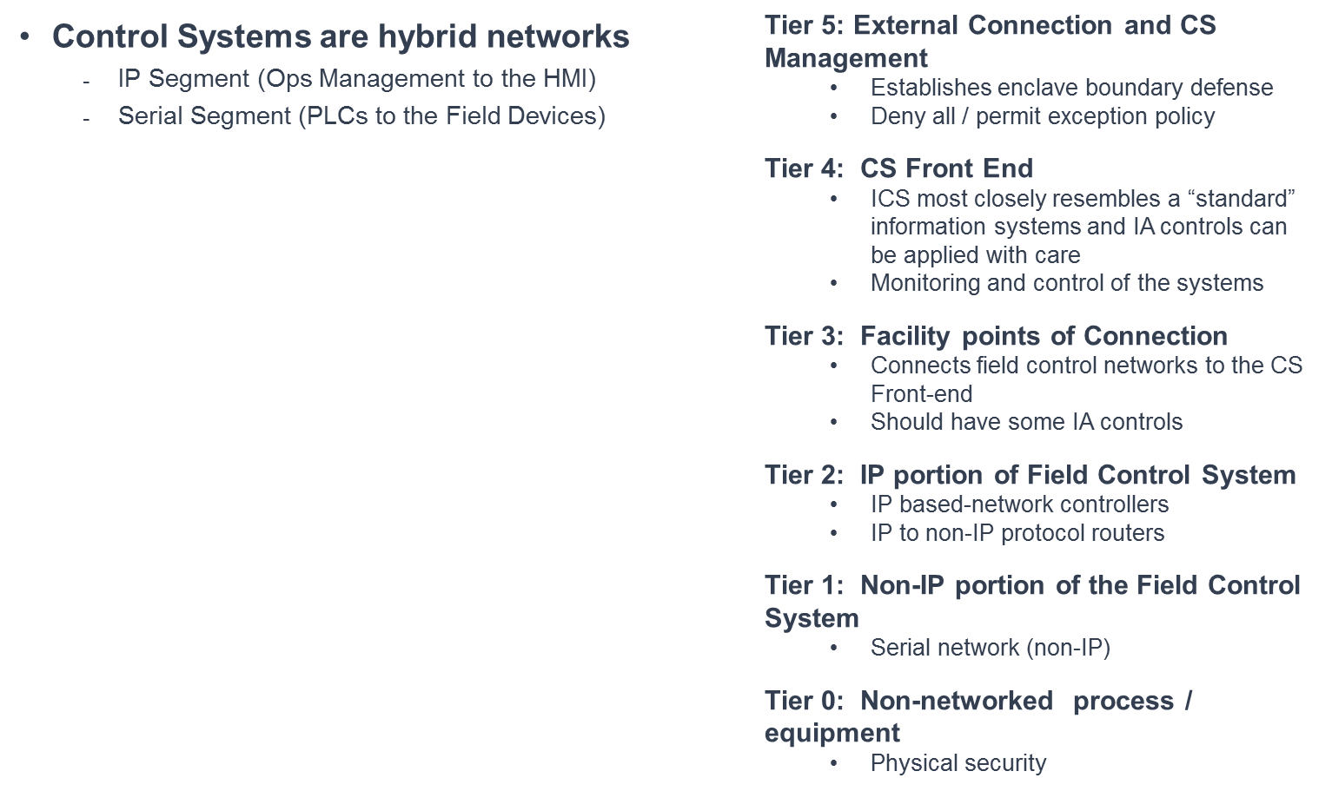
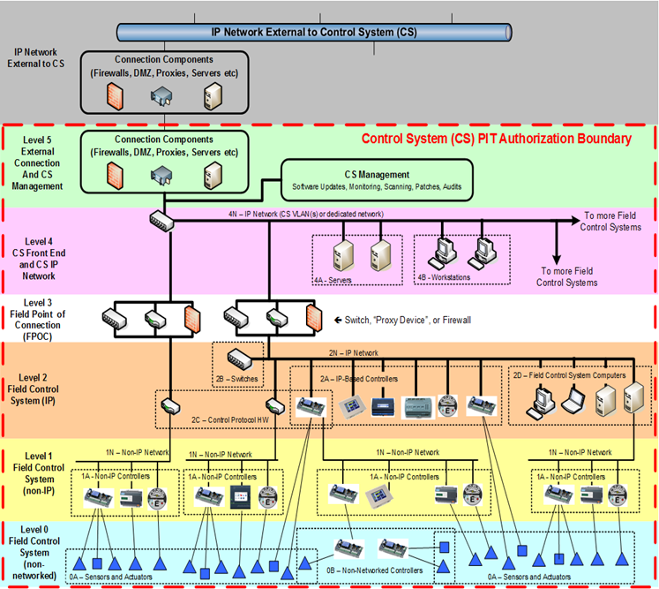
Source: Unified Facilities Criteria (UFC): Cybersecurity of facility-related controls systems (FRCS): 19 September 2016 Chang 1, 18 January 2107

